Slide 1
Monday

Slide 2
Course Logistics
Problem Set 2 – Due Wednesday, Feb. 22
PS1 grading is ongoing…
Project Milestone 2.1 – Due Next Week!
All you’re doing is providing constructive feedback

Slide 3
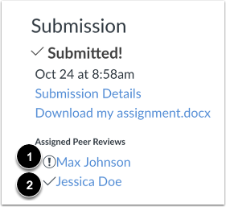
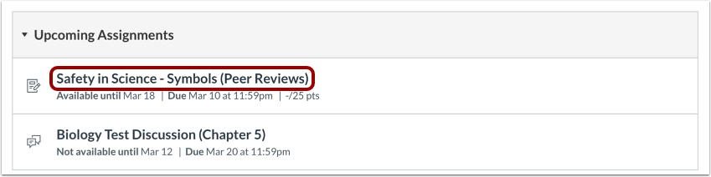

Completing Peer Review

Slide 4
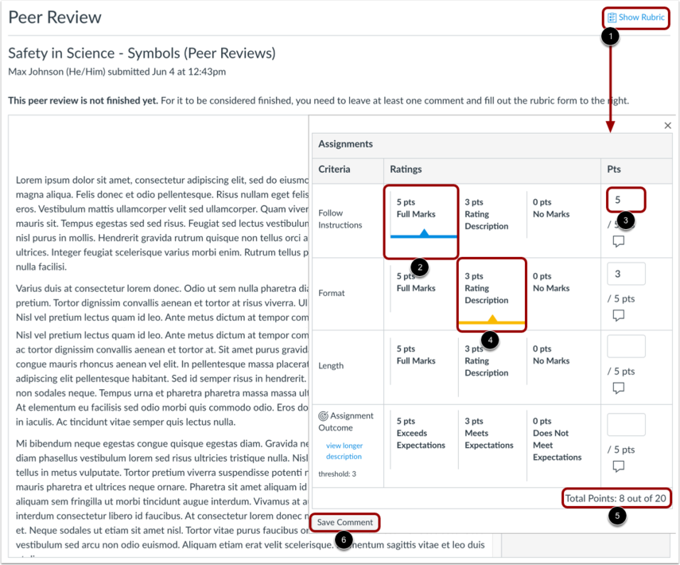
Completing Peer Review

Slide 5
PS2 Problem 2.7
Don’t worry about the QR Factorization step, just get a random choice of features
Used in sample_data

Slide 6

3 idiots

Slide 7

Aircraft Investigators

Slide 8

Big Hosses

Slide 9
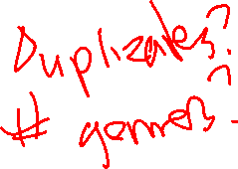
BoulderMusicML

Slide 10

Car Fellas

Slide 11
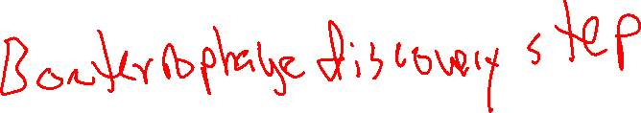
Darwinians

Slide 12

Diamond Handz

Slide 13

KGS

Slide 14

InSpect

Slide 15
Wednesday

Slide 16
Course Logistics
Problem Set 2 – Due Wednesday, Feb. 22 – today!
PS3 releases today
PS1 grading is ongoing…
Project Milestone 2.1 – Due Next Week!
All you’re doing is providing constructive feedback

Slide 17

Machine Yearning

Slide 18
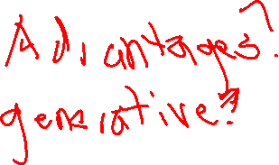
MIT or Bust

Slide 19

Neural Net Ninjas

Slide 20
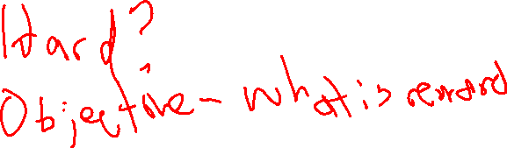
of the Concrete

Slide 21
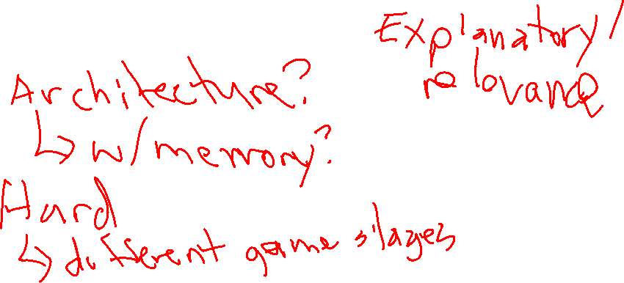
Pocket Aces

Slide 22

Powder

Slide 23
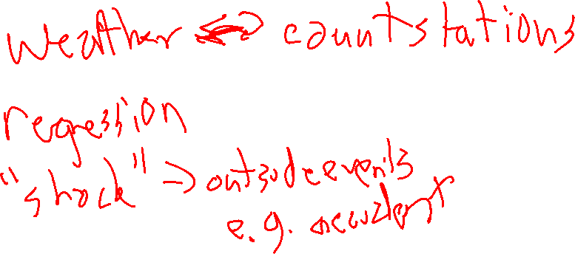
Project Impossible

Slide 24
Quigley’s disciples

Slide 25
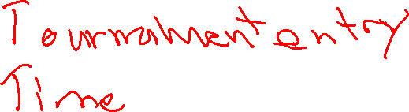
Snowfall

Slide 26
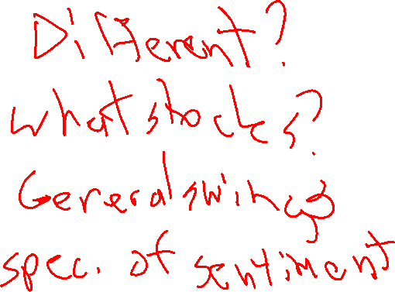
StockMind

Slide 27
Friday

Slide 28
Course Logistics
Problem Set 3 – Due Wednesday, March 8
That’s pretty close to Exam 1 (March 6th). What are your thoughts?
PS1, PS2 grading is ongoing…
Project Milestone 2.1 – Due Next Week!
All you’re doing is providing constructive feedback
Exam 1 – March 6
On Canvas, available all day, 50 minute time limit, course support during lecture slot…

Slide 29
Multi-Class Classification

Slide 30
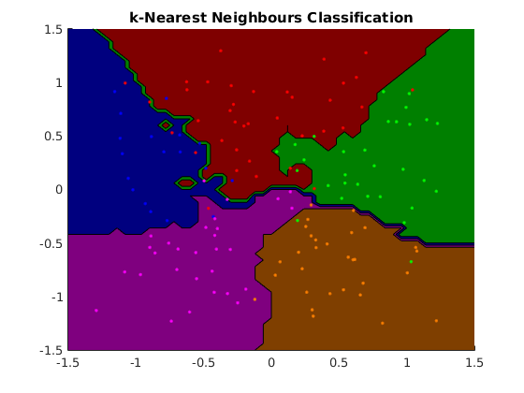
Multi-Class Classification - KNN
Notes:
https://www.cs.ubc.ca/~schmidtm/Software/matLearn/multiclass/demos/html/demo_multiclass_KNN_01.png

Slide 31
Classification vs. Binary Classification
Some methods are inherently binary
Logistic Regression
Perceptron
We’ll see more as the course develops

Slide 32
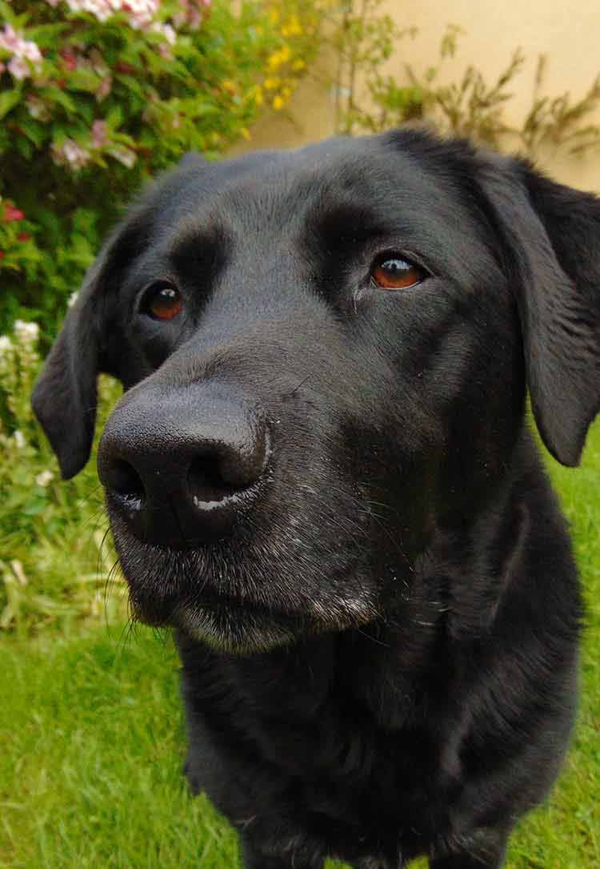
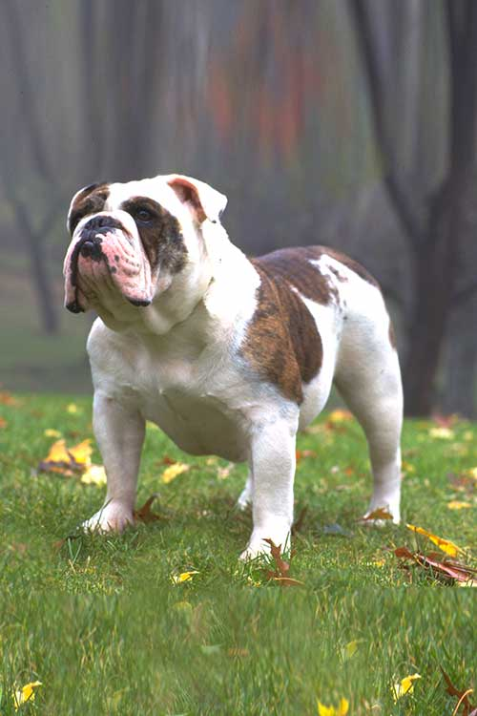


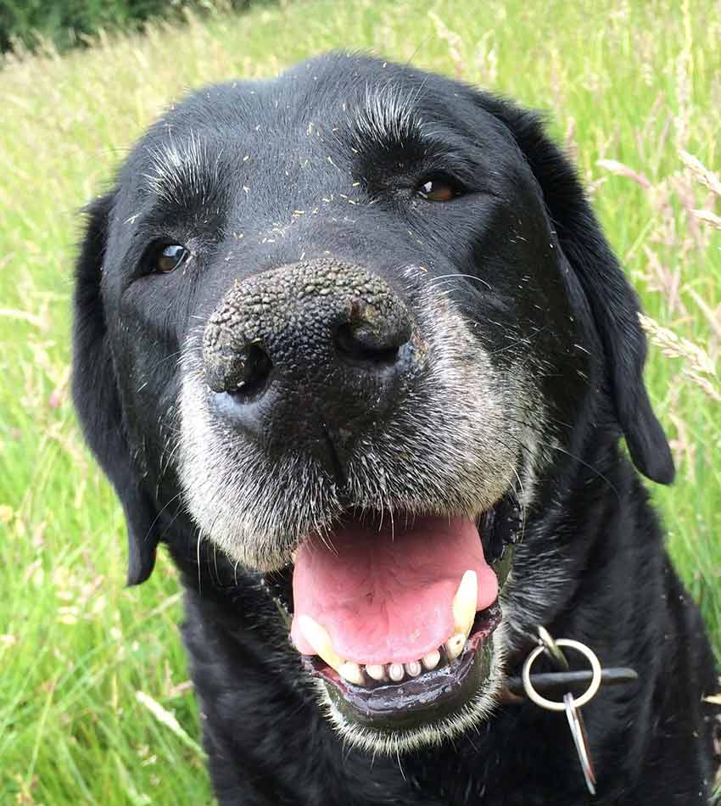
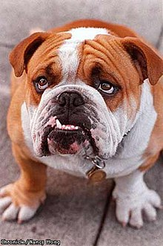

Multi-Class: One vs. All / One vs. Rest
For each class, we create a binary model
c vs. ~c
 | vs | vs | vs
 | - | - | +
 | + | - | -
 | - | + | -
Notes:
https://ybxzcgnc7b-flywheel.netdna-ssl.com/wp-content/uploads/2017/04/black-labs-loving-dogs.jpg
https://s3.amazonaws.com/cdn-origin-etr.akc.org/wp-content/uploads/2017/11/12235340/Bulldog-Care.jpg
https://cdn1-www.dogtime.com/assets/uploads/2011/01/file_23020_dachshund-dog-breed.jpg
https://www.purina.com/sites/g/files/auxxlc196/files/styles/kraken_generic_max_width_240/public/HOUND_Dachshund-%28Smooth%29.jpg?itok=DzMsCGPV
https://ybxzcgnc7b-flywheel.netdna-ssl.com/wp-content/uploads/2017/04/old-black-lab.jpg
https://upload.wikimedia.org/wikipedia/commons/thumb/e/e5/Axel%2C_the_English_Bulldog.jpg/220px-Axel%2C_the_English_Bulldog.jpg

Slide 33

Multi-Class: One vs. Another (All-Pairs)
For each pair of classes, we create a binary model
1 vs. 2, 1 vs. 3, 2 vs. 3, 1 vs. 4, 2 vs. 4, 3 vs. 4, etc.
 | vs | vs | vs
 | ? | B | A
 | A | A | ?
 | B | ? | B
Notes:
https://ybxzcgnc7b-flywheel.netdna-ssl.com/wp-content/uploads/2017/04/black-labs-loving-dogs.jpg
https://s3.amazonaws.com/cdn-origin-etr.akc.org/wp-content/uploads/2017/11/12235340/Bulldog-Care.jpg
https://cdn1-www.dogtime.com/assets/uploads/2011/01/file_23020_dachshund-dog-breed.jpg
https://www.purina.com/sites/g/files/auxxlc196/files/styles/kraken_generic_max_width_240/public/HOUND_Dachshund-%28Smooth%29.jpg?itok=DzMsCGPV
https://ybxzcgnc7b-flywheel.netdna-ssl.com/wp-content/uploads/2017/04/old-black-lab.jpg
https://upload.wikimedia.org/wikipedia/commons/thumb/e/e5/Axel%2C_the_English_Bulldog.jpg/220px-Axel%2C_the_English_Bulldog.jpg

Slide 34
Team Fr

Slide 35
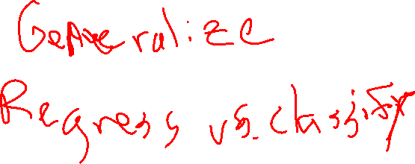
The Boats

Slide 36

The Ominous Corporation

Slide 37
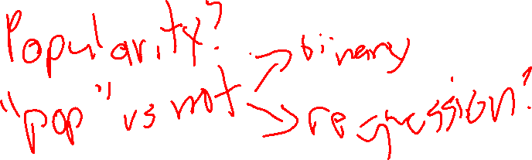
Wednesday Addams

Slide 38
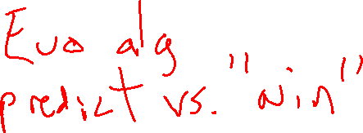
Undecided

Slide 39
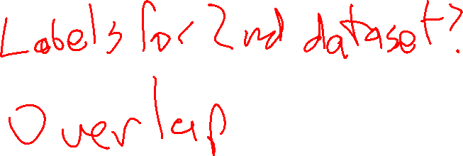
Yay

